Slide 1
Computer Science
Tony Gaddis 5th Ed Starting Out with C++
Chapter 2
Introduction to C++
Mohammad Al-Husseini

Slide 2
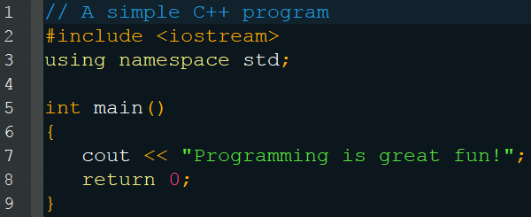
The Parts of a Program
Comments
Line 1, blue in this editor/layout (notepad++)
Preceded by //
Not part of the code, assists the programmers and readers of the code in knowing what the program and or code does

Slide 3
The Parts of a Program
Preprocessor Directives
Line 2, orange
Preceded by #
Sets up code for the compiler
Can create macros, constants, and more
In this case includes a library of code

Slide 4
The Parts of a Program
Namespaces
Line 3, yellow
Organizes the names of variables, functions, and objects much like a folder in an operating system
“Using” a namespace is generally frowned upon most programmers prefer std::cout << “etc.”;

Slide 5
The Parts of a Program
Functions
Line 5
All must have a return type (int), a name (main) and parameters contained within parenthesizes ()
All programs must contain a main (and only one)

Slide 6
The Parts of a Program
Braces
Lines 6 and 9
Marks the start and end of a function
Make sure that every brace, parenthesis, and bracket has a closing one for every starting one.

Slide 7
The Parts of a Program
Output
Line 7
cout displays text to the command prompt
<< (stream insertion operator) is used in conjunction with cout
“” contains the string to be outputted

Slide 8
The Parts of a Program
Return
Line 8
The information to be returned out of the function
The value 0 matches the int return type on line 5
For main, this is typically an exit code indicating if the program completed successfully

Slide 9
The Parts of a Program
Notes
Not all lines are terminated with a semicolon (;)
Preprocessor directives, braces, function headers, and comments (generally) never use semicolons
Although not the case in this example, most lines will be terminated with semicolons

Slide 10
The Parts of a Program
Notes
C++ is case-sensitive
iostream is different from Iostream or IOSTREAM or any such combination
Reserved words such as main, include, using, return, cout, and more must be all lowercase

Slide 11
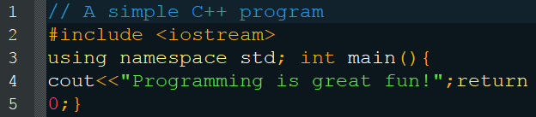
The Parts of a Program
Spacing doesn’t matter but is important

Slide 12
The cout Object
Outputs to the console
Classified as a stream object as it works with streams of data
Used with << to insert data into the stream (hence the stream insertion operator)
Accepts strings (“ex”), numbers, variables, certain keywords (endl), and more
Outputs exactly what you tell it to and does not automatically add whitespace

Slide 13
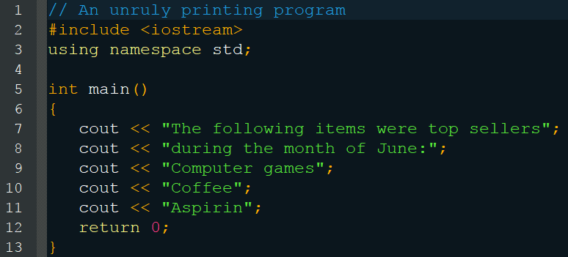
The cout Object
The following items were top sellersduring the month of June:Computer gamesCoffeeAspirin

Slide 14
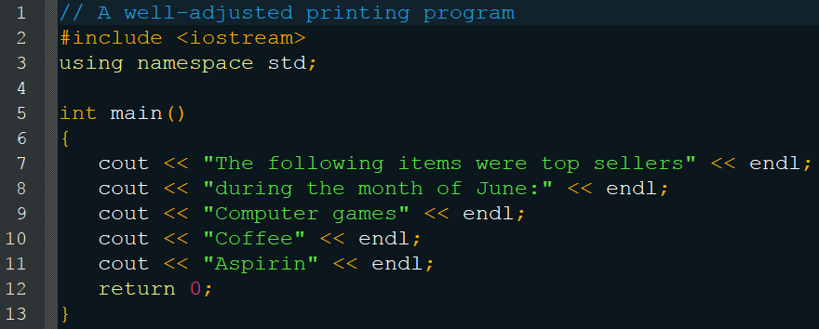
The cout Object
The following items were top sellers During the month of June: Computer games Coffee Aspirin

Slide 15
The cout Object
Common Escape Sequences
\n Newline
\t Horizontal Tab
\a Alarm
\b Backspace
\r Return
\\ Backslash
\’ Single Quote
\” Double Quote
Note: Do not put a space between the backslash and the character

Slide 16
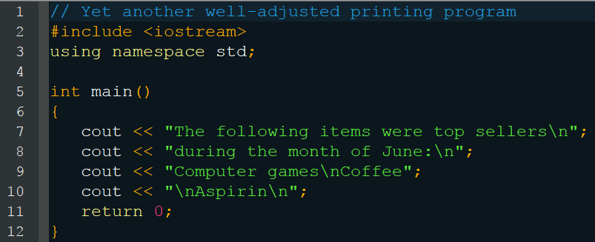
The cout Object
The following items were top sellers During the month of June: Computer games Coffee Aspirin

Slide 17
The #include Directive
Includes libraries of code that would be too difficult / repetitious to retype each time
Must include the name of a file
iostream, for example, is the name of the file containing the code that defines the cout object, which is not part of the core of C++
These preprocessor directives are not part of the code and, as such, are not terminated by a semicolon #include <iostream>

Slide 18
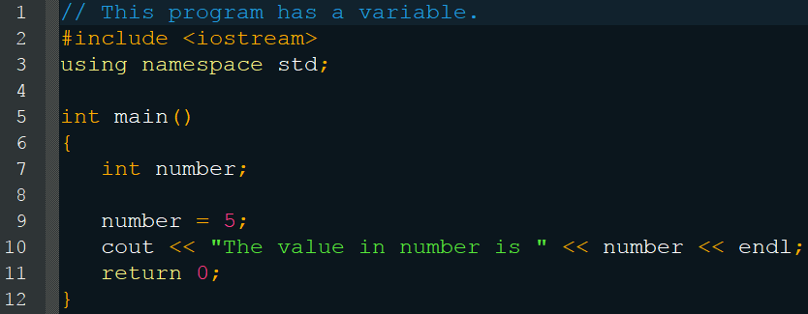
Variables
Allow you to work with data in memory, giving you an interface to RAM
Must be defined before trying to use them
Upon declaration, variables contain garbage data that is unusable
Until they are given a value by the code, their values cannot be accessed

Slide 19
Variables
Line 7 declares and defines the variable
Line 9 redefines the variable with the value 5
Line 10 accesses the value of the number variable to return the value 5 and pass the string “The value in number is 5” to cout
Note: Although line 7 defines the variable, its value is garbage and cannot be accessed (as in line 10) until it is redefined (as in line 9)

Slide 20
Variables
When declaring a variable, as on line 7, you must precede its name with a data type (int in this example)
Do not put quotations around the name of the variable when you try to access it (line 10)

Slide 21
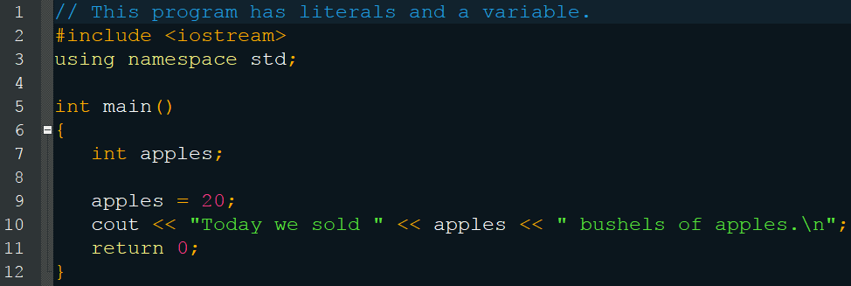
Literals
Values that do not change during the course of the program, unlike variables, also referred to as constants
Hold values without the need to reserve space in memory

Slide 22
Literals
The literals in this program are:
20 - Integer Literal
“Today we sold “ - String Literal
“Bushes of apples.\n” - String Literal
0 - Integer Literal

Slide 23
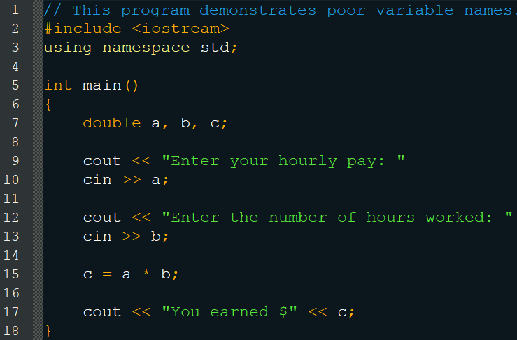
Identifiers
You are free to choose whatever names you want for your variables, with a few recommendations and exceptions
Pick meaningful names

Slide 24
Identifiers
You cannot use a key word (IDE will warn you)
asm | auto | break | bool | case
catch | char | class | const | const_cast
continue | default | delete | do | double
dynamic_cast | else | enum | explicit | extern
false | float | for | friend | goto
if | inline | int | long | mutable
namespace | new | operator | private | protected
public | register | reinterpret_cast | return | short
signed | sizeof | static | static_cast | struct
switch | template | this | throw | true
try | typedef | typeid | typename | union
unsigned | using | virtual | void | volatile
wchar_t | while

Slide 25
Identifiers
You must obey the following rules:
The first character must be a letter or underscore
After the first, you can use letters, underscores, or numbers
They are case-sensitive
dayOfWeek - Legal
_employee_num - Legal
June1997 - Legal
3dGraph - Illegal, begins with a number
Mixture#3 - Illegal, contains a character
that is not a letter, number, or underscore

Slide 26
Identifiers
Conventions:
Begin with a lowercase letter
Ex: apples
If two words, either separate with an underscore
Ex: total_pay
Or make the second word a capital letter
Ex: totalPay
This all improves readability
Ex: totalpay
Ex: TotalPay
Ex: avoidreallylongvariablenames

Slide 27
Data Types
Different containers for different data
Two real types
Characters
Letters
Strings of letters with meaning
Numbers
Whole
Decimal
Signed
Numbers of varying sizes
True/False logic

Slide 28
Char Data
This data type only holds a single character
char only takes 1 byte of memory
Must use single quotation marks with the character
char letter = ‘a’;
Can also use a whole number (integer)
char letter = 97;
This is the ASCII representation of the character a

Slide 29
Char Data
You have also seen character literals as strings
cout << “The letter is: “ << letter;
You will learn how to store these in variables later
These strings contain multiple characters and are encased with double quotation marks
They automatically contain a null terminator character that signifies their end
Hence they always contain multiple characters >= 2
T | h | e |  | l | e | t | t | e | r |  | i | s | : |  | \0

Slide 30
Integer Data
Only holds whole numbers
Size of the numbers storable varies
short
int
long
unsigned
Data Type | Size | Range
short | 2 bytes | -32,768 to 32,767
unsigned short | 2 bytes | 0 to 65,535
int | 4 bytes | -2,147,483,648 to 2,147,483,647
unsigned int | 4 bytes | 0 to 4,294,967,295
long | >= 4 bytes | -2,147,483,648 to 2,147,483,647
unsigned long | >= 4 bytes | 0 to 4,294,967,295

Slide 31
Integer Data
C++ will generally store long ints as regular ints
You must force this behavior using the L tag
long int number = 64L;
You may also create long long variables to be at least 8 bytes
There are other number systems as well
Hexadecimal 0xF4
Octal 031
Binary 01110100

Slide 32
Floating-Point Data
Holds fractional or decimal number values
There are no unsigned floating point types
float will automatically be promoted to double and long double will be demoted to double
float number = 1.5F;
long double number = 1.5L;
Data Type | Size | Range
float | 4 bytes | +/- 3.4E-38 to +/- 3.4E38
double | 8 bytes | +/- 1.7E-308 to +/- 1.7E308
long double | >= 8 bytes | +/- 1.7E-308 to +/- 1.7E308

Slide 33
Floating-Point Data
You may assign a floating point number to an integer, but the results may seem unexpected
The decimal portion will be truncated (lost) NOT rounded
int i; float f = 7.5; i = f; // i will equal 7
You may also assign integers to floating points without issue
Note that floating point numbers take much more memory than integers
Don’t use a double when you only need an int

Slide 34
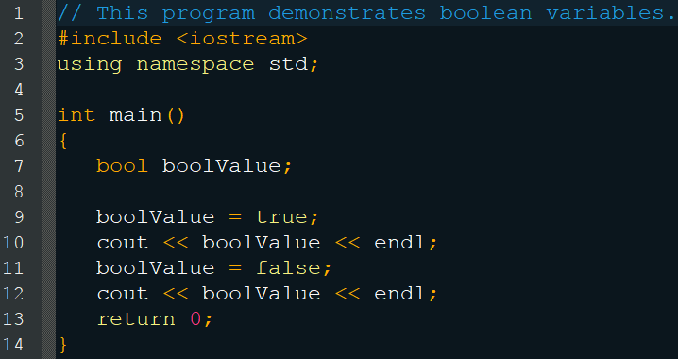
Bool Data
Represents true and false
Really stored as a number
false = 0
true = any non-zero value, usually 1
Outputs a 1 and then a 0

Slide 35
Data Type Size
All of the sizes listed before are for the average system
These sizes vary depending on your operation system
You can determine the size of a data type on your system using the sizeof operator
sizeof(variable or datatype)

Slide 36
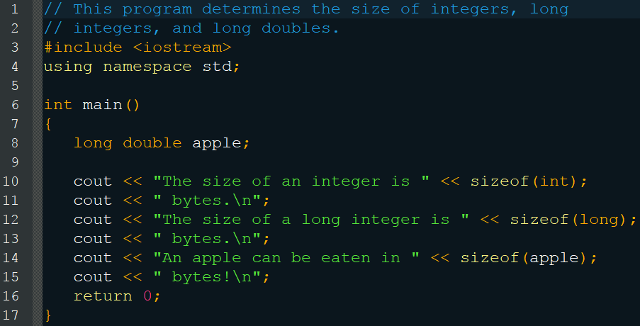
Data Type Size
The size of an integer is 4 bytes.
The size of a long integer is 4 bytes.
An apple can be eaten in 8 bytes!

Slide 37
Variable Assignments
Assignment operator =
Works with two operands
Right operand must be an rvalue (expression that has a value)
Left operand or lvalue must have a location in memory
unitsSold = 12;
12 = unitsSold; // Wrong

Slide 38
Variable Initializations
You may declare and initialize a variable in a single statement
double interestRate = 12.9;
You may also declare/initialize multiple variables in one statement
int month = 2, days = 28;
int flightNum = 89, travelTime, departure = 10, distance;

Slide 39
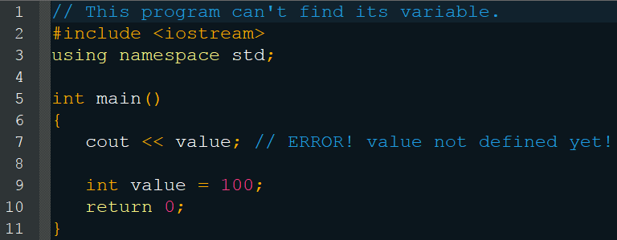
Scope
You cannot use a variable (and many other things) before you have declared them

Slide 40
Arithmetic Operators
Three varieties
Unary
Binary
Trinary
This number of operands sometimes determines which operator you are using
Ex. -
number = -5; // Unary negation operator
number = 5 - 1; // Binary subtraction operator

Slide 41
Arithmetic Operators
+ Addition
- Subtraction/Negation
* Multiplication
/ Division
% Modulus
Order of operations just like math
Be careful with division
double number = 21 / 2; // The result is 10
21 and 2 are integers, thus integer division
double number = 21 / 2.0; // Correct 10.5

Slide 42
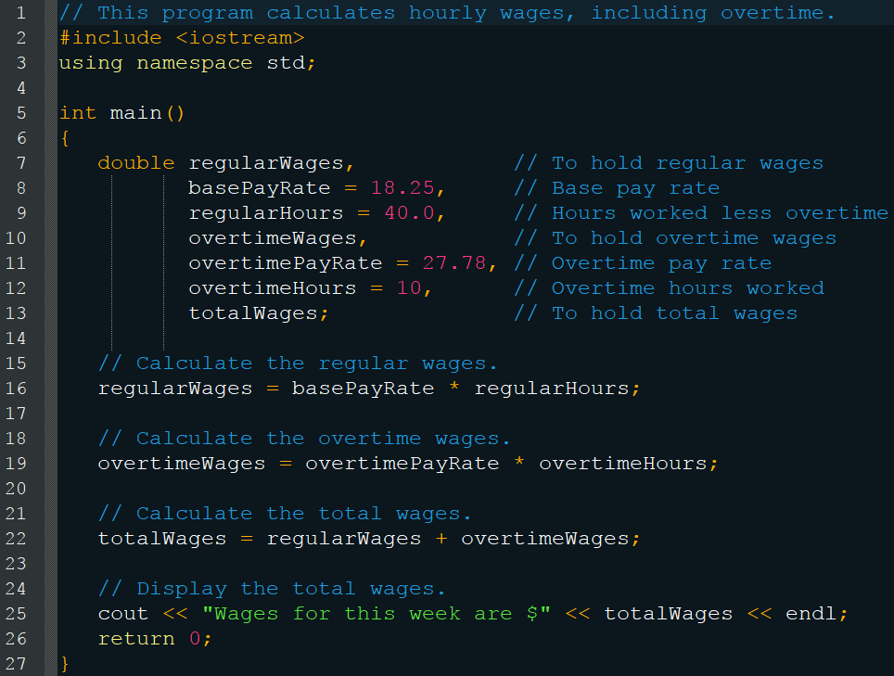
Arithmetic Operators

Slide 43
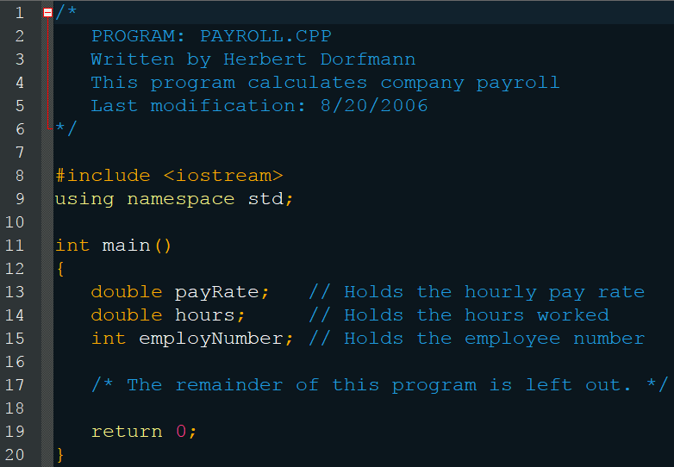
Comments
Single line comments are proceeded by //
Multiline comments start with /* and end with */

